Slide 1
For-Hire Drivers
Uber/Lyft/Grubhub/etc.
Notes:
This is not a lesson in how to prepare Schedule C or the details of all the pertinent tax laws

Slide 2
For-Hire Drivers – Income
For-Hire Drivers report earnings on Schedule C
Uber/Lyft/etc. business code: 485990 All other transit and ground passenger transportation
Grubhub/DoorDash/etc. business code: 492000 Couriers and messengers
Loss on Schedule C is out of scope
Review documents during interview for scope
Taxpayers determine their income, mileage and other expenses
Notes:
Changed business code for Uber/Lyft/etc.
Third party network transaction means any transaction that is settled through a third party payment network, but only after the total amount of such transactions exceeds $20,000 and the aggregate number of such transactions exceeds 200.
However ...
Minimum thresholds of greater than $20,000 and more than 200 transactions do not apply to payment card transactions
Taxpayer should give you the total income earned, deductible miles and business expenses. We can assist and advise but we should not be the bookkeeper/accountant.

Slide 3
For-Hire Drivers – Income
Income reporting documents
Statement from the payer showing income, commissions and fees, mileage, etc.
Taxpayer needs to print from his/her online account
Form 1099-MISC
Form 1099-K common with Uber/Lyft
Payment Card and Third Party Network Transactions
May also receive cash (tips for example)
Notes:
Third party network transaction means any transaction that is settled through a third party payment network, but only after the total amount of such transactions exceeds $20,000 and the aggregate number of such transactions exceeds 200.
However ...
Minimum thresholds of greater than $20,000 and more than 200 transactions do not apply to payment card transactions

Slide 4
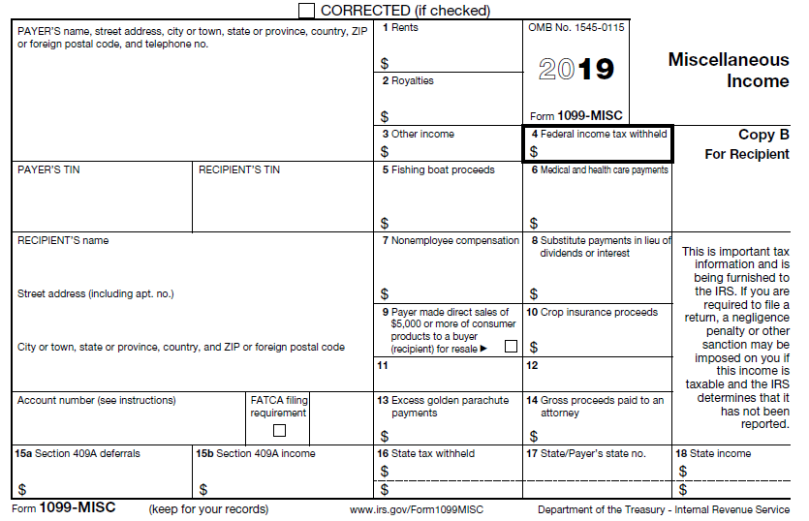
Form 1099-MISC
Tax form may or may not be received.
Enter amount on 1099-MISC and attach to Schedule C
5,605

Slide 5
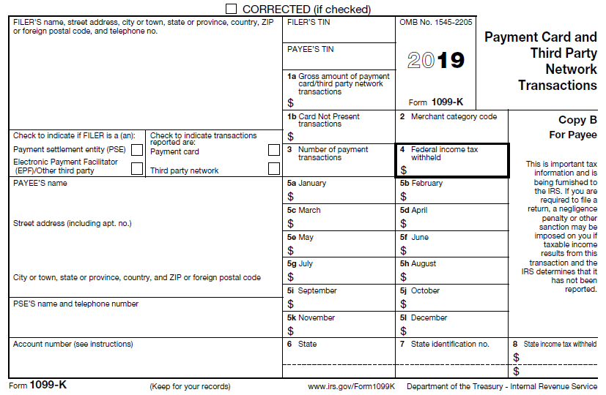
Form 1099-K
Tax form may or may not be received.
Enter box 1a amount on Schedule C as gross payment
Enter tax withheld in Payments and Estimates section
Boxes 1b and all 5 boxes are subsets of box 1a. No need to enter these.

Slide 6
Form 1099-K or If No Tax Form (TaxSlayer)
Select Schedule C and enter in first Income field
Selecting 1099-K simply takes you to Schedule C entry page anyway
Total of Form(s) 1099-K plus cash income, but not Form(s) 1099-MISC income.

Slide 7
For-Hire Drivers – Expenses
Standard mileage rate (58¢/mile for 2019) in scope for For-Hire Drivers
Must use standard mileage rate in first year vehicle used for business or otherwise forever foreclosed from using that method for that vehicle
Out of scope if actual vehicle expenses claimed
First and last ride of day to and from home are nondeductible commuting miles unless taxpayer claims home office deduction (which is out of scope)

Slide 8
For-Hire Drivers – Expenses
Detailed records essential
Total mileage – business, commuting and other
Business expenses
Business use and purpose
All expenses must be reported – even if result is a net loss (which is out of scope)

Slide 9
For-Hire Drivers – Expenses
Add to standard mileage business portion of
Tolls: 100% business use when incurred as For-Hire Driver
Parking: 100% business use when incurred as For-Hire Driver
Auto loan interest
Auto personal property taxes
Taxpayer to determine business portion based on miles driven or other reasonable method when property not 100% business
Example:
Business miles 4,500 ÷ Total miles 45,000 = 10% business use
$1,000 interest paid on auto loan in 2019
$1,000 X 0.10 = $100 deductible auto loan interest on Schedule C

Slide 10
For Hire Drivers – Expenses
Examples of potentially 100% business use expenses
Uber/Lyft/Grubhub/etc. fees
Device subscription fees
Snacks and water for passengers
Passenger cell phone accessories, such as chargers and cables
Mileage tracking software
Airport fees
Business license
Ride sharing insurance
Dash camera
Notes:
List of additional expenses are examples and not intended to limit only these expenses
Note Dash Camera may be 100% business use or ratable

Slide 11
For Hire Drivers – Expenses
Examples of ratable business-use expenses
Cell phone and mount
Flashlights and flares
First aid kit
Road-side assistance plans
Dash camera
Notes:
List of additional expenses are examples and not intended to limit only these expenses
Note Dash Camera may be 100% business use or ratable

Slide 12
For Hire Drivers – Expenses
Examples of expenses included in standard mileage rate that are not deductible as business-use expenses
Maintenance and repairs
Oil changes
Car washes
Fuel
Normal insurance
Vehicle registration fees

Slide 13
For-Hire Drivers – Quality Review
Review payer statement and tax forms (1099-K and 1099-MISC)
Verify amount of cash income (tips) added to Schedule C
Confirm only business portion of expenses claimed
Remind taxpayer to maintain accurate written documentation of mileage and expenses

Slide 14
For Hire Drivers

